Slide 1
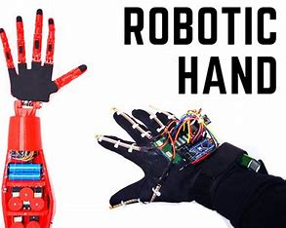
MAJOR PROJECT
NON CONTACT HAND GESTURE
BASED WIRELESS ROBOT
PRESENTED BY B. MOUNIKESH GOUD

Slide 2
contents
INTRODUCTION
EXISTING SYSTEM
PROPOSED SYSTEM
COMPONENTS AND TOOLS
BLOCK DIAGRAM
WORKING PRINCIPLE
ADVANTAGES
DISADVANTAGES
APPLICATIONS
FUTURE SCOPE

Slide 3
INTRODUCTION
Gestures have been one of the oldest way of communication. Hand gestures have been developed as part of languages which are used to communicate with disabled people. Gestures are usually classified into two categories namely static and dynamic.
Static gestures are easier to handle than dynamic gestures. Static gesture basically involves a certain pose for indicating a certain instruction whereas dynamic gesture involves analyzing movement for certain amount of time. Allowing users to use gesture to control devices makes computer human interaction more natural.

Slide 4
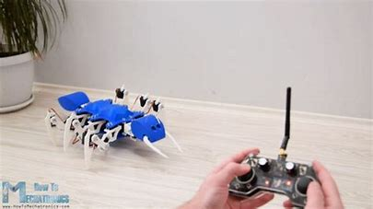
EXISTING SYSTEM
The Existing System which the project using in that robot is having the same transmitter and the receiver section but the only difference is that it require controller to control the robot. In that case the Robot can only be controlled using the buttons or joystick.

Slide 5
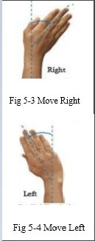

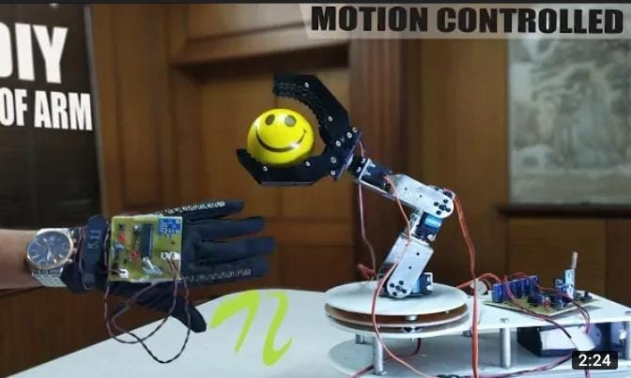
PROPOSED SYSTEM
We propose a system named Hand Gesture Controlled Robot. The principal objective is to produce reliable and a more convenient technique for the user to move a wireless robot within the environment using gestures.
Gesture controlled robot uses hand gestures to regulate the motion of the robot, rather than employing a device with buttons or a joystick.

Slide 6
COMPONENTS AND TOOLS
HARDWARE COMPONENTS
Flex sensors
Arduino nano
Arduino atmega 2560
MEMS sensors
Zigbee module
Batteries
LM293D driver
Motors
Servo motors
SOFTWARE COMPONENTS
Arduino ide, C++

Slide 7
BLOCK DIAGRAM
Transmitter Receiver
Battery(9v)
Battery(12v)
ARDUINO NANO
Atmega
328
ARDUINO Atmega
2560
MEMS sensor
Zigbee
Motor 1
Servo 1
LM293 Motor Driver
Flex sensor1
Servo Driver
Flex sensor 2
Zigbee
Motor 2
Servo 2

Slide 8
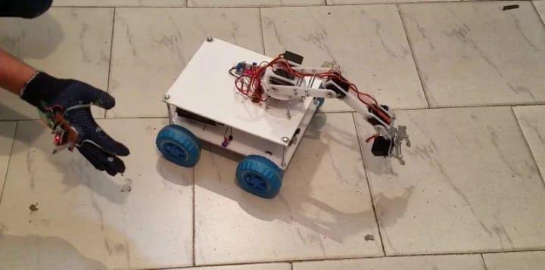
WORKING PRINCIPLE
Accelerometer based gesture controlled robot moves according to the movement of hand as we place the accelerometer on your hand. When we tilt hand with an accelerometer in front of the robot, then the robot starts moving forward until the next movement is given. When we tilt hand in backward direction, then the robot changes its direction and state. Then it starts moving in backward direction until the next signal is given. When we tilt hand on left side, then the robot moves into left side until the next signal is given. In the same way, when we tilt hand in right side, then the robot moves right side.

Slide 9
advantages
Due to wireless communications data rate is faster.
It is easy to design and manufacture as all the components are easily available.
Power consumption is less.
It is low cost of manufacturing.

Slide 10
disadvantages
It cannot sense the hand gesture movements from long distance.

Slide 11
applications
It can be used in remote rural areas, so as to carry out operations like military appliances
It can also be used for laboratory, bomb disposals.
We can apply it for garbage removal in lakes.

Slide 12
THANK YOU

